Slide 1
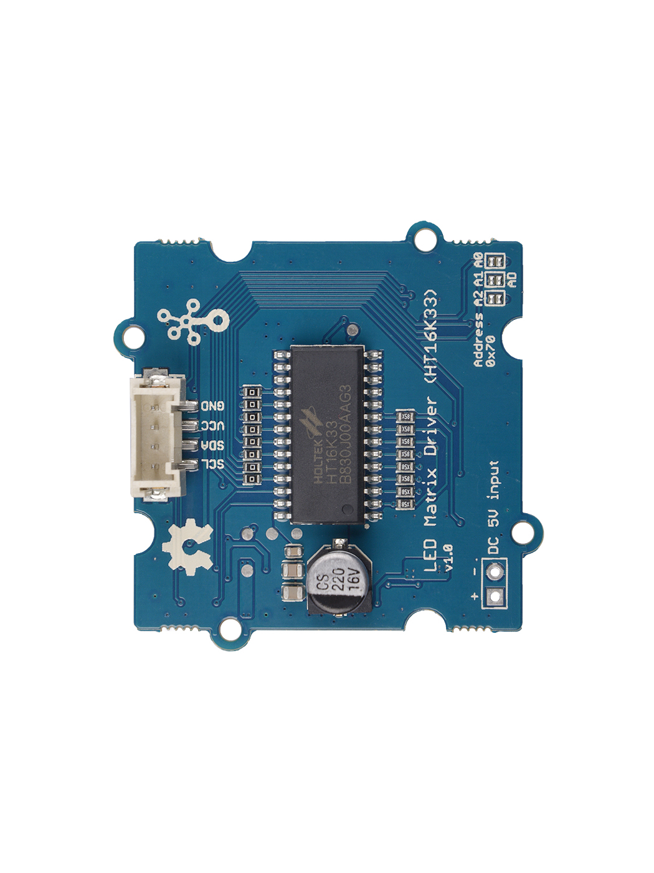




A0
A1
A2
0 x 73
GND: connect this module to the system GND
VCC: you can use 5V or 3.3V for this module
SDA: I²C serial data
SCL: I²C serial clock

Slide 2
Default 0 x 73
A0
A1
A2

